Slide 1
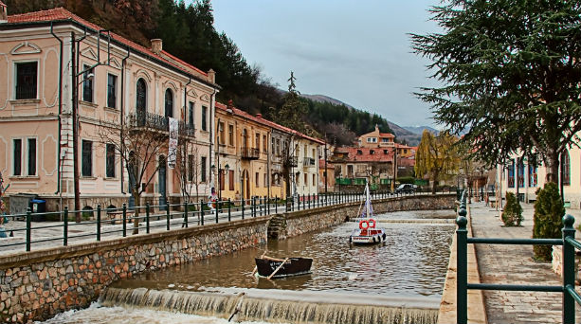
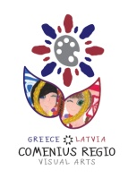
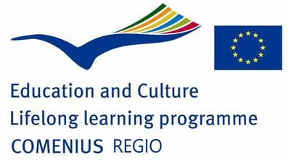
artists
Visual arts, creativity and intercultural education based on local artistic repository

Slide 2
Just 100 years since the liberation of Florina city are enough to indicate that the visual arts constitute a cultural capital for this region. In this period, more than seventy artists - half of them have studied at the Academy of Fine Arts, whereas the others are self-taught-, created a cultural context, in which a wide variety of artwork has emerged.
Florina: The artistic development

Slide 3
About the second half of the 18th century, the traditional artists and, specifically, the self-taught painters from non-urban areas, was presented their artistic production. The iconography, as traditional art, was developed in Drosopigi of Florina, a village that still nowadays monopolizes the iconographic activity of the region.
The names of the iconographers:
John Styliadis, Stylianos Styliadis, Anastasios Styliadis, Stylianos Zografos and his son Stergios, and Pantelis Thomas. Also, Leonidas Zografos (son of Stergios), Markos Styliadis (son of Anastasios), Constantinos Tziatzios and Charisios Charrisis.
Florina: The artistic development

Slide 4
The production of the self-taught artists derives its themes from the neoclassical spirit of the era. The lyricism of the «atmospheric» paintings and the detailed design was led us to conclude that the artists of this period imitated the Italian standards. These artists are: Dimitris Linaras, Dimitris Boutzios, Ilias Byzantis, Leonidas Pavlidis, Giorgos Bliankas, Dimitris Krullis and Alekos Sampsonidis.
Their subjects and techniques make clear not only the aesthetic spirit of this period but also the cultural background, which they have inherited. Apart from Linaras, who painted aquarelles, all the others painted with oil paintings
1940s: Creating the infrastructure of visual movement in Florina

Slide 5
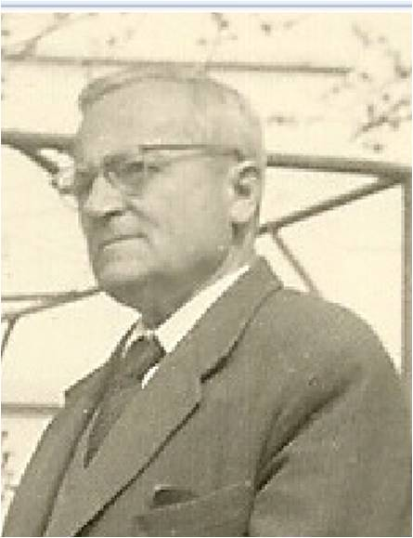
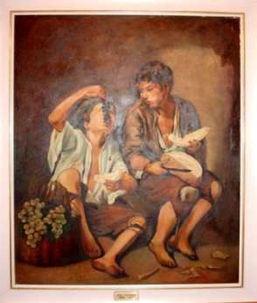
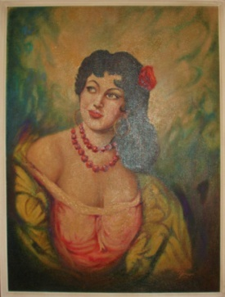
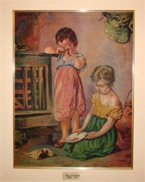
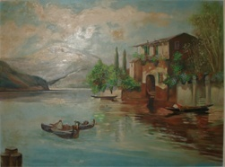
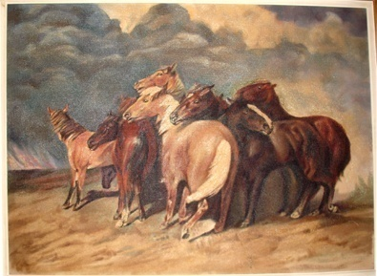
Dimitris Linaras
Dimitris Linaras was born in Monastiri in 1894. There, he attended the Greek primary school and continued his studies in a Turkish High school. His family settled to Florina in 1914, during the population exchanges. He studied at the School of Fine Arts in Athens. He is the noteworthy artistic case of the prewar period in Florina. His paintings consist of oil paintings and aquarelles. He also used to replicate portraits and postcards.

Slide 6

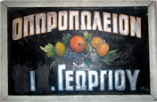


Ilias Vyzantis
Ilias Byzantis was born in Istanbul in 1910. In 1922 his family was settled in Florina. His work consists of two parts: the sign-making and the painting. He made hundreds of signs in the city of Florina with a characteristic style of writing. Byzantis’ painting consists of frescos with religion theme.

Slide 7
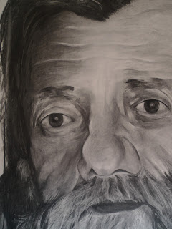
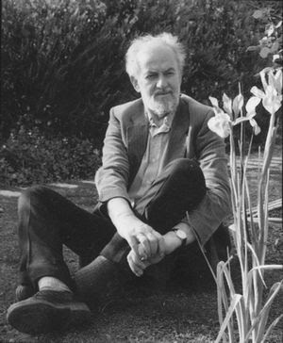
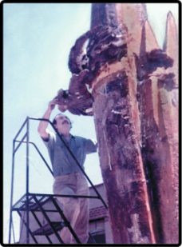
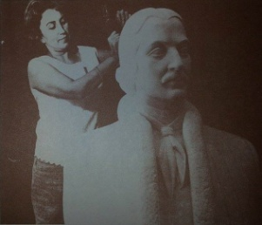
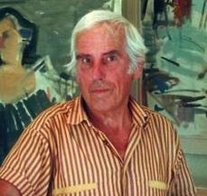
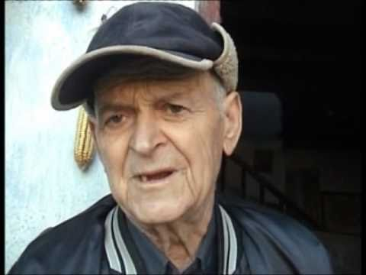
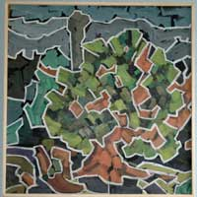
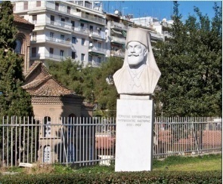
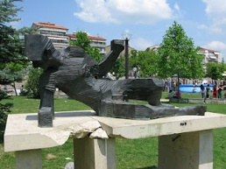
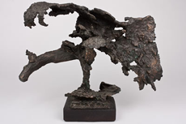
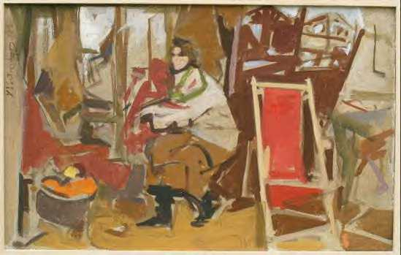
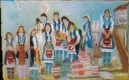
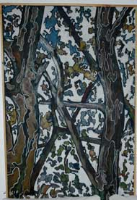
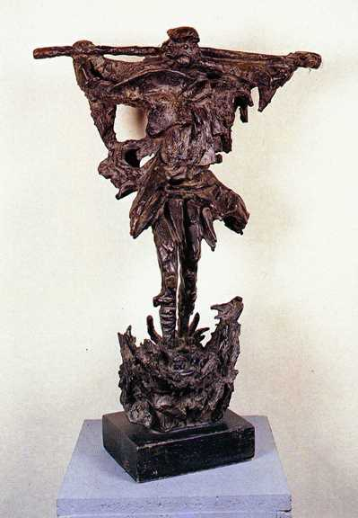
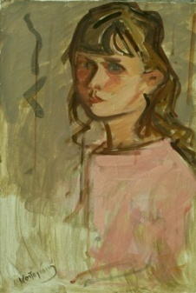
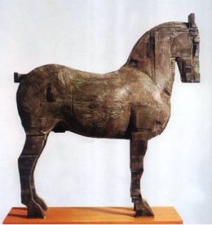
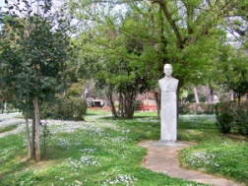
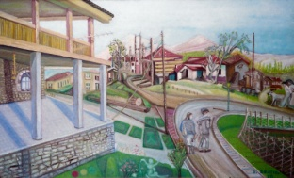
Sterikas Koulis
Aliki Chatzi
Dimitris Kalamaras
Giorgos Koras
Kostas Kontoyiannis
Dimitris Dostis
1921-1995
1923-1997
1924-1997
1925 -
1926-2000
1928 -

Slide 8
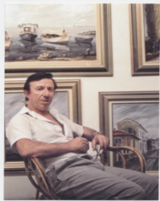
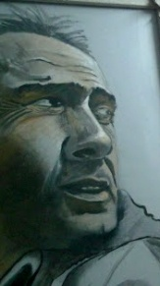
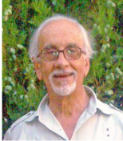
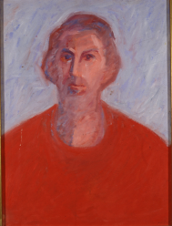

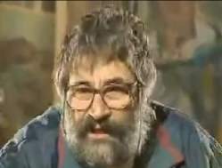
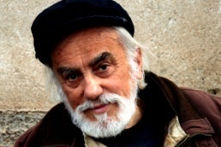
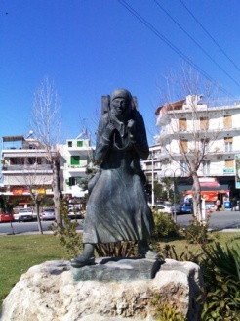
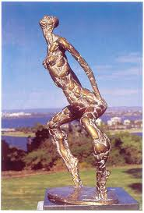
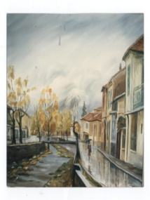
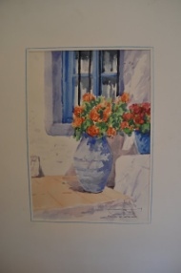
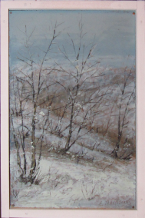
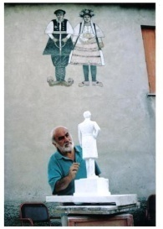
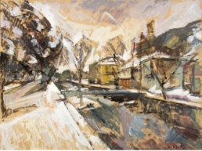
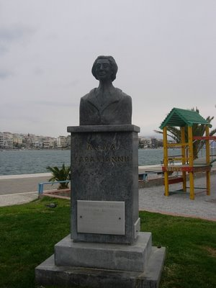
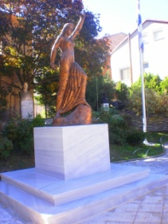
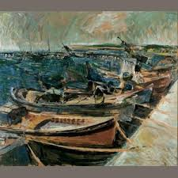
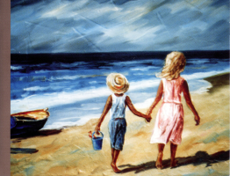
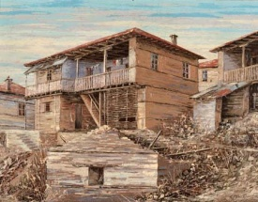
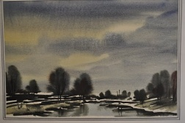
Thanasis Minopoulos
Leonidas Kalamaras
Kostakis Loustas
Vaggelis Mparas
Yiannis Antoniadis
Vaggelis Tamoutselis
Nikolas Dogoulis
1931-1982
1932 -
1933 -
1933 -
1935 -
1935 -
1937-2013

Slide 9
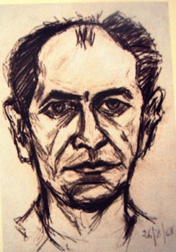
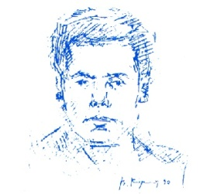
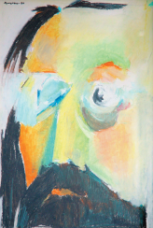


















Aris Ioannou
Marika
Thoidou – Athanasiou
Vassilis Kyrkos
Thanasis Konstantinidis
Grigoris Catzilamprou
Themis Milosis
Vyssios Xanthippos
Takis Bessas
1940-
1940 -
1942 -
1942 -
1946 -
1946 -
1947 -
1947 -

Slide 10


















Vassilis Michail
Manolis Polymeris
Thanasis Kalamaras
Yiannis Moulelis
Floel
Giorgos Pastakas
Lazaros Spyrou
1950-
1951 -
1951 -
1954 -
1955 -
1956 -
1958 -

Slide 11
























Litsa Papadimitriou
Stella Gkolitsi-Kounoupi
Sotiris Lioukras
Thomas Zografos
Zoi Tyrpenou
Anna Tsoulfidou
Nikos Tamoutselis
Pantelis
Tamoutselis
1960-
1962-
1962 -
1963 -
1963 -
1963 -
1967 -
1969 -

Slide 12

















Marianna Kizou
Christos Kountouras
Mpampis Chrysohoidis
Maria Chatzilampou
Natassa Rachovitsa
Melina Yialama
1971-
1974 -
1974 -
1975 -
1977 -
1977 -

Slide 13














Filippos Kalamaras
Olga Kerkezi
Anastasios Thomou
Vaggelis Theodoridis
Antonis Mpalakas
1978 -
1978 -
1978 -
1980 -
1981 -

Slide 14






Nikos Mponas
Giorgos Chatzis
1969 -

Slide 15
artists
Visual arts, creativity and intercultural education based on local artistic repository

