Slide 1



Making Art Accessible for Elementary Students

Slide 2
Importance of Art for Students
Art is a visual language that provides another means of communication
The openness of art instruction (many solutions, not single answers) naturally allows the expressions or voices of multiple learners.
How can all students become empowered and engaged in learning experiences?

Slide 3
What Makes an Individual Well Rounded?
Arts are essential to a well-rounded person and healthy future
Providing opportunities where all of our students participate in the arts is paramount to assisting our students to becoming more well-rounded.

Slide 4
Art
Art is a conduit to experiencing life long learning in ways that are creative and encourage problem finding and solving
Art also provides opportunities to observe, participate in and strengthen aesthetic awareness and critical thinking (likes and dislikes)
Built into art classrooms are ways our students can participate in a community of diverse learners since the art teacher sees almost all students in the school and has them for the entire time that they attend that school.

Slide 5
Art
One way to provide empowerment to all of our students is through educating ourselves to learn how to provide and model best practices of accommodating and improving accessibility to learning and participating in the rich visual language of art
To make this happen there needs to be collaboration between the educator and the art educator

Slide 6
Communication Strategies
WAIT!
Build in opportunities to communicate
Have boards with specific vocabulary available and ask the educational staff to train students how to use them

Slide 7
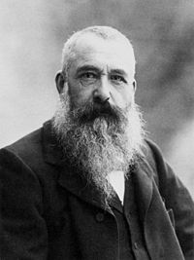

Impressionism: Claude Monet
http://upload.wikimedia.org/wikipedia/commons/thumb/a/a4/Claude_Monet_1899_Nadar_crop.jpg/200px-Claude_Monet_1899_Nadar_crop.jpg

Slide 8
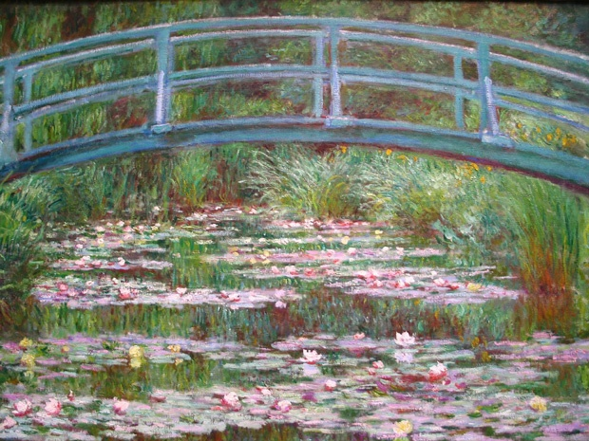
Water Lilies and Japanese Bridge
(1897-1899)

Slide 9
Example of a PowerPoint that could be used with students
Provides extra practice on fewer standards
Used in addition to other art activities

Slide 10



Elements of Art
Line
Shape
Color

Slide 11
LINES
A line is the path of a point moving through space.
Let’s look at some lines

Slide 12
Straight lines

Slide 13
Wavy lines

Slide 14
Making Art Accessible for Elementary Students

